Slide 1

TradeWise AI
An Intelligent Stock
Trading Assistant
Raz Waiss 315495622
Niv Dahan 308215086
Mentor: Mr. Alex Keselman

Slide 2

Introduction
The problem we aim to solve is the need for an automated, AI-driven system that can process large volumes of data quickly and provide accurate buy/sell recommendations tailored to different trading styles.
Some platforms offer AI-driven stock predictions.
The proposed solution is to develop a full-stack web application that leverages AI to provide automated buy/sell recommendations for stocks.
The solution will be useful to Individual Traders ,Financial Advisors, Investment Firms ,Educational Institutions.

Slide 3

The problem
Stock trading is complex and fast-paced.
Traders face the challenge of analyzing large amounts of data, leading to time-consuming, error-prone decisions.
Manual analysis of technical indicators and fundamentals is overwhelming for both novice and experienced traders.
80% of retail traders lose money due to a lack of informed decisions.

Slide 4
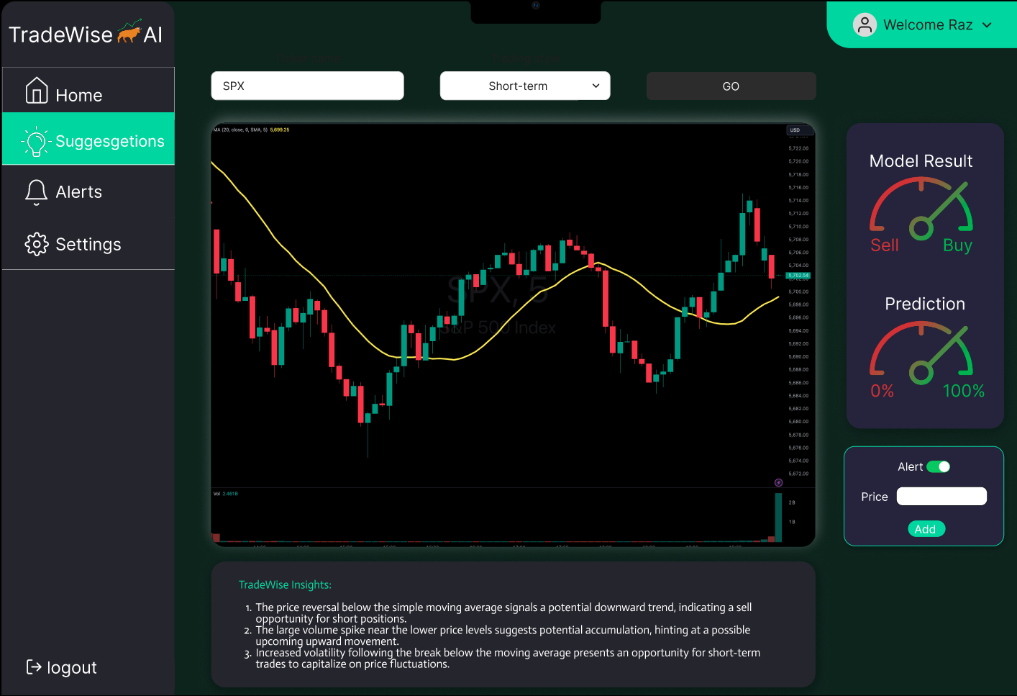
The solution
AI-powered web application that automates buy/sell recommendations.
Tailored to individual trading styles .
Integration of both technical and fundamental analysis for more informed decisions.

Slide 5
How it works
Stock Data
AI Model
Recommendation
User
Collect real-time and historical stock data using APIs.
Analyze stock data with machine learning models to generate recommendations.
Display predictions and stock data in a user-friendly interface.
Allow users to customize their trading preferences and receive alerts.

Slide 6


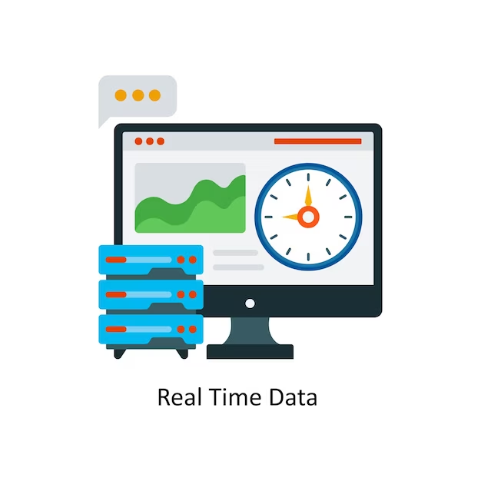

Key Features
AI-Powered Stock Recommendations: Automated predictions based on data analysis.
Customizable Trading Preferences: Tailor recommendations based on user input.
Real-Time Data Integration: Access real-time stock data from financial APIs.
Alerts & Notifications: Get notified when stock conditions meet predefined criteria.

Slide 7
System Architecture
Backend: Node.js & Express for handling API requests and user authentication.
Frontend: React.js for a dynamic, user-friendly interface.
Database: MongoDB for storing user data, stock history, and AI predictions.
AI/ML: Python (TensorFlow, Scikit-learn) for developing machine learning models.
Frontend (React.js)
User Request
Backend (Node.js, Express.js)
Send Stock Data
AI Model (TensorFlow, Python)
Display Recommendations
Return Predictions
Store/Retrieve Data
Database (MongoDB)

Slide 8

AI Model Overview
The AI model analyzes stock data using machine learning algorithms.
Trained on historical stock data to predict buy/sell signals.
Factors in technical indicators (e.g., RSI, moving averages) and fundamentals (e.g., earnings reports).

Slide 9
Success Criteria
Accuracy of AI Predictions:
The AI model should surpass traditional methods in reliability and profitability.
Validated through backtesting with historical data and live testing with real-time data.
User Satisfaction:
Positive feedback regarding ease of use, effective recommendations, and user interface.
High ratings for customization options and overall performance.
Performance and Scalability:
Ability to handle large volumes of data and multiple users without slowdowns or crashes.
Continuously monitored post-deployment for performance.
Security and Data Integrity:
Secure user data with encryption and robust authentication.
Regular security audits to ensure data integrity and prevent breaches.

Slide 10
System Test Plan
 | Tested Function | Tested Module | Testing Plan | Expected Result
1 | User login | Authentication Module | Verify that a user can log in with valid credentials. Test with both valid and invalid credentials. | The user logs in successfully with valid credentials; receives an error for invalid.
2 | Stock Recommendations | AI Model Module | Provide sample stock data and check if the AI model generates buy/sell recommendations based on technical analysis (e.g., moving averages, RSI). | The AI model generates accurate and timely buy/sell recommendations.
3 | Data Retrieval from Financial API | Backend (API Integration) | Test API integration by fetching real-time stock data from the financial API (e.g., Alpha Vantage or Yahoo Finance). | The API retrieves accurate real-time and historical stock data without errors.
4 | Customizing Trading Preferences | Preferences Module | Test whether users can customize their trading preferences (e.g., trading style, risk tolerance) and if the system applies these settings correctly. | The system stores and applies the user’s custom preferences to the recommendations.
5 | Receiving Alerts | Notification System | Set alerts for specific stock conditions (e.g., when a stock price crosses a threshold) and verify that notifications are sent when conditions are met. | The user receives accurate and timely notifications based on their set criteria.

Slide 11



Target Audience
Retail Traders: Make smarter decisions without needing expert-level knowledge.
Financial Advisors: Provide data-driven advice to clients.
Investment Firms: Automate decision-making to optimize portfolio management.

Slide 12

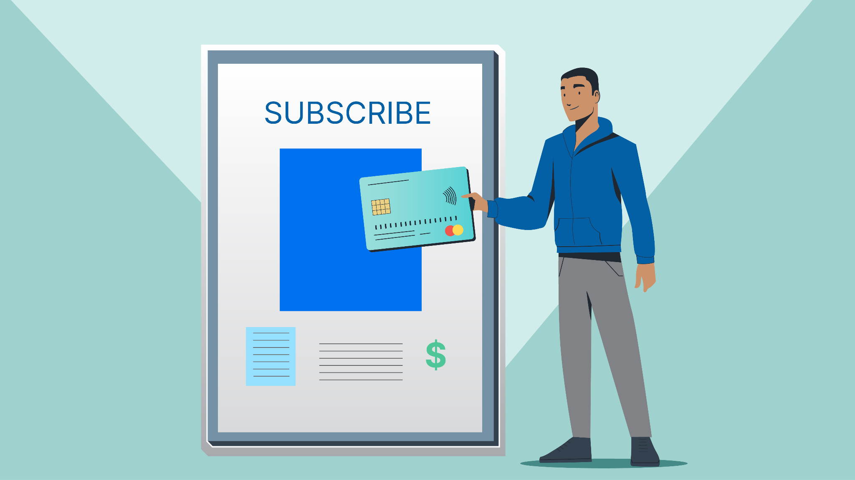

Monetization Strategy
Subscription-based Model: Monthly or yearly subscription fees for premium features.
Freemium Model: Basic access for free, with premium AI features at an additional cost.
Enterprise Solutions: Tailored versions of the platform for investment firms or larger traders.

Slide 13
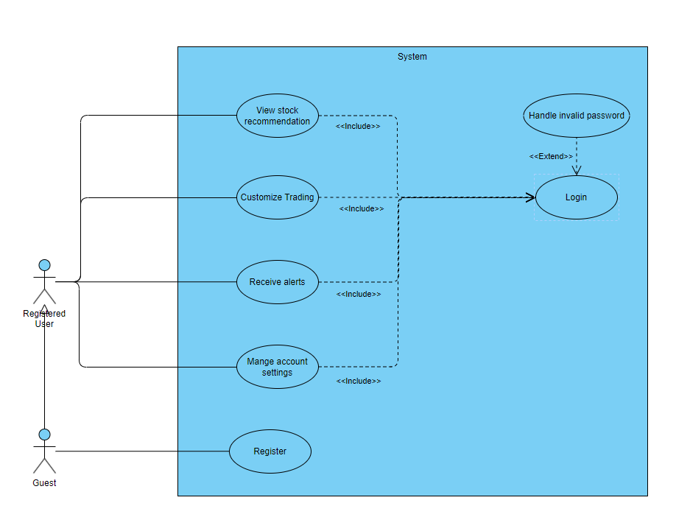
Use-Case Diagram

Slide 14

Questions?

